Slide 1
11.5 Self-adjoint and skew-adjoint linear operators

Slide 2
Introduction
In this topic, we will
Define self-adjoint and skew-adjoint linear operators
See that symmetric real matrices and conjugate symmetric complex matrices are self-adjoint
See that skew-symmetric real matrices and conjugate skew-symmetric complex matrices are skew-adjoint
Learn that every linear operator is the sum of a self-adjoint and a skew-adjoint linear operator

Slide 3
Definitions
A linear operator A:U → U is said to be self-adjoint if
for all vectors u, v ∈ U
A linear operator A:U → U is said to be skew-adjoint if
for all vectors u, v ∈ U

Slide 4
Applications
Self-adjoint operators are critical in your course in quantum mechanics
Operators that extract information about position, momentum, energy, etc. of particles must be self-adjoint

Slide 5
Real self-adjoint operators
The adjoint of a real matrix is the transpose of that matrix
Given a square matrix A, then the entries of the transpose are:
For these to be equal, we require
In other words, a real square matrix is self-adjoint if the entry above the diagonal equals the entry in its reflection through the diagonal
Because of this property, we call such matrices symmetric

Slide 6
An example of a symmetric matrix
The following matrix is symmetric, and is therefore is self-adjoint:

Slide 7
Example
Let’s check if that’s actually true:

Slide 8
Example
If we change even one value, it no longer holds:

Slide 9
Example
If, however, we use the transpose, we get the same result

Slide 10
Complex self-adjoint operators
The adjoint of a complex matrix is the conjugate transpose of that matrix
Given a square matrix A, then the entries of the conjugate transpose are:
For these to be equal, we require
In other words, a complex square matrix is self-adjoint if the entry on or above the diagonal equals the conjugate of the entry in its reflection through the diagonal
Because of this property, we call such matrices conjugate symmetric

Slide 11
Complex self-adjoint operators
Theorem
The diagonal entries of a conjugate symmetric matrix are real.
Proof:
If , then if i = j, it follows that
This is only true if the diagonal entries are all real. ▮

Slide 12
Example
Let’s check if that’s actually true:

Slide 13
Example
If the matrix is symmetric and not conjugate symmetric, it no longer holds:

Slide 14
Example
If, however, we use the conjugate transpose, the values are equal

Slide 15
Real skew-adjoint operators
The adjoint of a real matrix is the transpose of that matrix
Given a square matrix A, then the entries of the transpose are:
For A^{T} = –A, we require
In other words, a real square matrix is skew-adjoint if the entry on or above the diagonal equals the negation of the entry in its reflection through the diagonal
Because of this property, we call such matrices skew-symmetric

Slide 16
Real self-adjoint operators
Theorem
The diagonal entries of a skew-symmetric matrix are zero.
Proof:
If , then if i = j, it follows that
This is only true if the diagonal entries are all zero. ▮

Slide 17
An example of a symmetric matrix
The following matrix is skew-symmetric, and is therefore is skew-adjoint:

Slide 18
Example
Let’s check if that’s actually true:

Slide 19
Example
If we change even one value, it no longer holds:

Slide 20
Complex skew-adjoint operators
The adjoint of a complex matrix is the conjugate transpose of that matrix
Given a square matrix A, then the entries of the conjugate transpose are:
For A = –A*, we require, we require
In other words, a complex square matrix is skew-adjoint if the entry on or above the diagonal equals the negation of the conjugate of the entry in its reflection through the diagonal
Because of this property, we call such matrices conjugate skew-symmetric

Slide 21
Complex self-adjoint operators
Theorem
The diagonal entries of a conjugate skew-symmetric matrix are imaginary.
Proof:
If , then if i = j, it follows that
This is only true if the diagonal entries are all imaginary. ▮

Slide 22
Example
Let’s check if that’s actually true:

Slide 23
Example
Note that this equality is false if the matrix is skew-symmetric:

Slide 24
Comment on terminology
Just like the conjugate transpose is sometimes called the Hermitian transpose
A conjugate symmetric matrix is sometimes said to be a Hermitian matrix
A conjugate skew-symmetric matrix is sometimes said to be a skew-Hermitian matrix

Slide 25
From calculus
Recall that a function is even if f (–t) = f (t) for all t
The term even comes from the fact that all even powers of t share this property
Consider the polynomial 3t⁶ + 2t² + 5 :
3(–t)⁶ + 2(–t)² + 5 = 3t⁶ + 2t² + 5
Recall that a function is odd if f (–t) = –f (t) for all t
The term odd comes from the fact that all odd powers of t share this property
Consider the polynomial 3t⁷ + 2t³ + 5t :
3(–t)⁷ + 2(–t)³ + 5(–t) = –( 3t⁷ + 2t³ + 5t )

Slide 26
From calculus
Theorem
Every function is the sum of an even and an odd function.
Proof:
This is a constructive proof.
Let and .
Note that , and
Thus, f is the sum of an even and an odd function. ▮

Slide 27
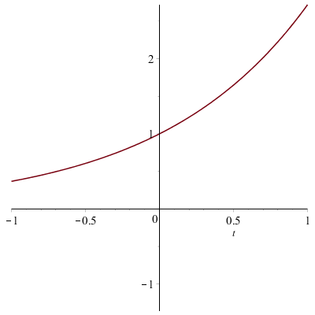
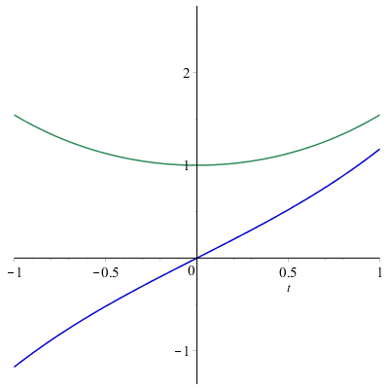
From calculus
Note that the Taylor series of
An even function f (t) is comprised entirely of even powers of t
An odd function f (t) is comprised entirely of odd powers of t

Slide 28
Linear operators
Theorem
Every linear operator is the sum of a self-adjoint and a skew-adjoint operator.
Proof:
Define and .
Note that
Thus, the statement is true. ▮

Slide 29
Example
Consider the following real matrix:

Slide 30
Summary
Following this topic, you now
Know what a self-adjoint and skew-adjoint linear operator is
Understand that a real symmetric matrix is self-adjoint and a real skew-symmetric matrix is skew-adjoint
Understand that a complex conjugate symmetric matrix is self-adjoint, and a conjugate skew-symmetric matrix is skew-adjoint
Know that every linear operator is the sum of a self-adjoint and a skew-adjoint linear operator
Know the defining feature of a self-adjoint operator is
and the defining feature of a skew-adjoint operator is

Slide 31
References
[1] https://en.wikipedia.org/wiki/Self-adjoint
[2] https://en.wikipedia.org/wiki/Symmetric_matrix
[3] https://en.wikipedia.org/wiki/Hermitian_matrix

Slide 32
Acknowledgments
None so far.

Slide 33
Colophon
These slides were prepared using the Cambria typeface. Mathematical equations use Times New Roman, and source code is presented using Consolas. Mathematical equations are prepared in MathType by Design Science, Inc.
Examples may be formulated and checked using Maple by Maplesoft, Inc.
The photographs of flowers and a monarch butter appearing on the title slide and accenting the top of each other slide were taken at the Royal Botanical Gardens in October of 2017 by Douglas Wilhelm Harder. Please see
https://www.rbg.ca/
for more information.

Slide 34
Disclaimer
These slides are provided for the ne 112 Linear algebra for nanotechnology engineering course taught at the University of Waterloo. The material in it reflects the authors’ best judgment in light of the information available to them at the time of preparation. Any reliance on these course slides by any party for any other purpose are the responsibility of such parties. The authors accept no responsibility for damages, if any, suffered by any party as a result of decisions made or actions based on these course slides for any other purpose than that for which it was intended.

